Slide 1
VOD RECOMMENDATION MODEL

Slide 2

VOD Recommendation Model - Overview
Top-K recommendation - Create a recommendation model that displays most relevant few VODs to users interested in Rentals/Purchases.
Recommendation Systems are of 2 types:

Slide 3
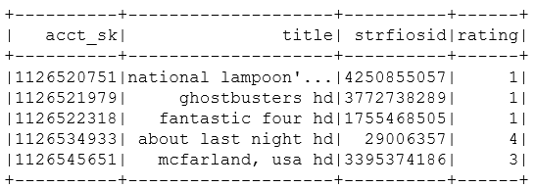
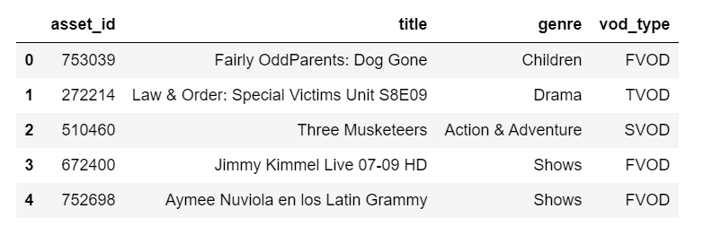
Collaborative Filtering - Model Logic
The model will make use of two tables as the dataset:
Ratings table VOD Assets
The model works by
Looking through the whole ratings of a user in the ratings table.
Looking for other users that have VODs in common with similar ratings.
Finding the VODs that those other users have watched.
Predicting a rating score of how much the user would like the VODs that have been watched by the other users.
Looking for the VODs with the highest predicted score for the user in the VOD table.
Taking the VOD details from the VOD table and making a list of the VODs with the highest predicted rating for each user.

Slide 4

Collaborative Filtering – Data Expectations
The Collaborative Filtering model expects a Ratings Table that contains:
User ID
Movie Title/Movie ID
Rating
The Rating can be either an explicit rating or an implicit rating:
For our case we created implicit ratings/feedback values because we did not have an explicit rating/feedback.
To obtain such value, a user’s taste profile using latest months of data was created to arrive at the model’s dataset expectations.

Slide 5
Implicit Ratings Formulation:
Rating = (Movie Rating) + (Genre Rating * 0.3)
Movie Rating:
Computation based on customer’s viewership data:
For Purchase : 2 + (#times * # hours watched )
For Rent : 1 + (#times * # hours watched )
For Free : 0 + (#times * # hours watched)
Genre Rating Computation:
= (4 * #hours watched) + (3 * #purchases) + (2 * #rents) + (1 * price of movies)

Slide 6
Model Dataset - Construction Steps
Creating a table at Genre level – Part I
Table contained historical data aggregated at Genre level
The goal of this table was to obtain an implicit score for each genre watched by each customer to determine each customer’s most liked genres.
Weights were given to the factors of that table to obtain an implicit value for Genre
The Scores are then scaled on a scale of 1-5 to get a comparative score of each user.
ACCT_SK | HISTORICAL USAGE (6 Months)
 | GENRE | Total Spent | Total Hours of Genre watched | RENTAL_COUNT | PURCHASE_COUNT
123 | COMEDY | 22 | 5 | 2 | 1
123 | ACTION | 12 | 4 | 0 | 1
123 | THRLLER | 3 | 2 | 1 | 0
123 | HORROR | 0 | 1 | 0 | 0
Weight Given | Factors
1 | Total Spent
4 | Total Hours
2 | Rental_Count
3 | Purchase_Count
10

Slide 7
Model Dataset - Construction Steps
Creating a table at Genre level – Part II
Each given weight was multiplied to its corresponding Factor value and then all the weights were summed to obtain an implicit genre score for each genre watched by each customer.
ACCT_SK | HISTORICAL USAGE (6 Months)
 | GENRE | Total Spent | Total Hours of Genre watched | RENTAL_COUNT | PURCHASE_COUNT
123 | COMEDY | 22 | 5 | 2 | 1
123 | ACTION | 12 | 4 | 0 | 1
123 | THRLLER | 3 | 2 | 1 | 0
123 | HORROR | 0 | 1 | 0 | 0
ACCT_SK | HISTORICAL USAGE (6 Months)
 | GENRE | Implicit Genre Value
123 | COMEDY | (0.1*22)+(0.4*5)+(0.2*2)+(0.3*1)
123 | ACTION | (0.1*12)+(0.4*4)+(0.2*0)+(0.3*1)
123 | THRLLER | (0.1*3)+(0.4*2)+(0.2*1)+(0.3*0)
123 | HORROR | (0.1*0)+(0.4*1)+(0.2*0)+(0.3*0)
Weight Given | Factors
0.1 | Total Spent
0.4 | Total Hours
0.2 | Rental_Count
0.3 | Purchase_Count
As a final step - “Final Implicit Value” was bucketed based on quantiles to keep all values in a specific range for a balance dataset.

Slide 8
Model Dataset - Construction Steps
Creating a table at Genre level
Mapping the implicit value for Genre to a table containing factors at VOD level
Table created contained historical data aggregated at user/VOD level
Same as with the genre level table - weights were given to the factors of that table to obtain an implicit value for each factor
ACCT_SK
 | Movie ID | Movie Title | Genre | Implicit Genre Value | Times Watched Based on VOD being Rented, Purchased or Free
123 | 1214 | Title of Movie | COMEDY| ACTION | ComedyGenreValue + ActionGenreValue | 4
123 | 3520 | Title of Movie | HORROR| THRLLER | HorroGenreValue + ThrillerGenreValue | 1
“Times Watched” column was bucketed based on quantiles because the overall range was very wide.

Slide 9
Model Dataset - Construction Steps
Step 2: Mapping the implicit value for Genre to a table containing factors at VOD level – Continued…
Same as with the genre level table - weights were given to the factors of that table to obtain an implicit value for each factor
Same steps as with the genre level table were applied – each weight value was multiplied to its corresponding factor value and then all the weights were summed to obtain an implicit rating score.
The “Times Watched” column was divided in cases and given different weighted depending of if the movie had been watched Free,Rented or Purchased.
Since there might have been scenarios were the VOD might had been watched for free and also rented or purchased, the highest weighted was give in this scenario.
Weight Given | Factors
NA/Already done | Genre Implicit Weight Value
0 | Times_Watched - Free
1 | Times_Watched – Rent
2 | Times_Watched - Purchase
Acct_SK | Movie Title | Implicit Rating = sum of all the Weights * Factors
123 | Title of Movie | Genre Implicit Weight Value + (Weight Given * Times Watched)
As a final step - “Implicit Rating” was scaled on a range of 1 to 5(similar to ratings on IMDB) to keep all values in a specific range for a balance dataset.

Slide 10
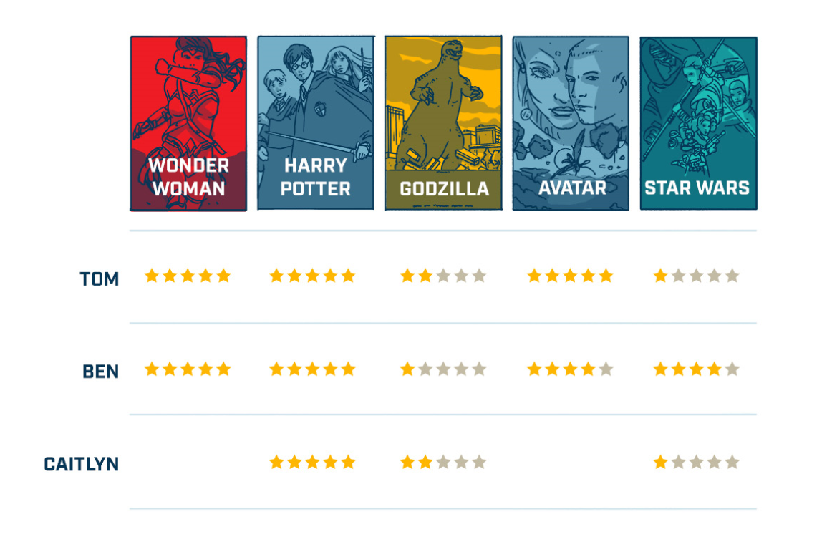
Collaborative filtering Rating’s Matrix

Slide 11
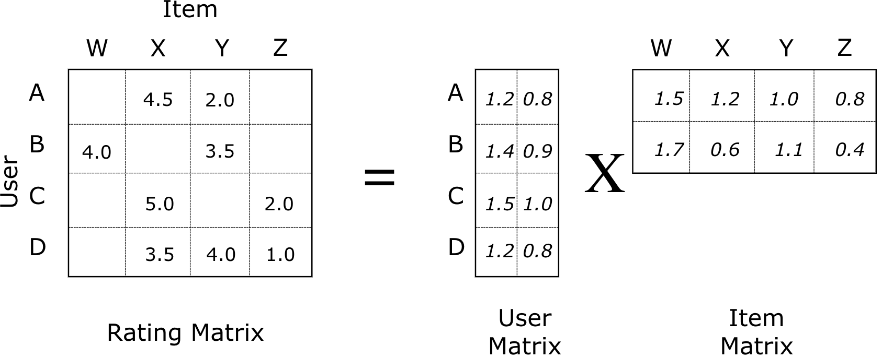
Alternating Least Squares model
The ratings matrix is used as the base for the model.
The ratings matrix is in higher dimension containing both User and Item components. This matrix can be decomposed into 2 matrices that are in lower dimensions.
One matrix can be seen as the user matrix where rows represent users and columns are latent factors. The other matrix is the item matrix where rows are latent factors & columns represent items.

Slide 12
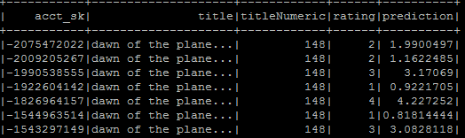
Model Validation Phase - Results
Metric | Accuracy Results
MSE | 0.6621
RMSE | 1.5328
MAE | 0.46932

Slide 13







Sample Recommendation for a User:
Titles watched by User in the previous month:
New Titles Recommended for the User:
89% Match
91% Match
93% Match
93% Match

Slide 14










Model Recommendation - Use Case
Movies Watched with Highest Rank (Rank: 5)
Action/Comedy
Drama/Sci-Fi
Action/Comedy
Comedy/Drama
Comedy/Drama
Top Movies Recommended by Model
Drama/Mystery
4.78
Adventure/Comedy
(4.86)
Action/Comedy
4.66
Drama/Mystery
4.66
Drama
4.75

